Slide 1
Welcome
We will begin shortly

Slide 2
Reinforcement Learning with LLMs Learning Experience
Lead Instructor: Tyler Jackson
Technical Support Lead: Jo Jabour

Slide 3
Please Ensure the Following:
You have an IDE ready to use that can interpret Python 3.7 or higher
You have Python 3.7 or higher downloaded on your machine
You have admin rights on your machine and can download packages onto it
You will be using the same machine for the second part of this workshop
The outlets at your table work (if needed for computer charging, etc.)
We will have more time during the workshop to ensure everyone is ready to start
WE WILL BEGIN SHORTLY

Slide 4
Meet the Instructors and Collaborators
Instructor: Tyler Jackson
Technical Support Lead: Jo Jabour
Joshua Church, et. al

Slide 5
Objectives
Gain a solid understanding of the core principles behind both Reinforcement Learning (RL) and Large Language Models (LLMs)
Explore how RL and LLMs function independently, including key architectures, algorithms, and use cases
Learn how RL can be used to fine-tune and align LLMs, such as in Reinforcement Learning from Human Feedback (RLHF)
Develop hands-on experience with coding projects that combine RL techniques with LLM-based tasks
Examine real-world applications where LLMs and RL work together, and draw inspiration for future research or product development

Slide 6
Setup Details
Codebase Reviews and Breaks:
Codebase Reviews are for hands-on coding problem sets and debugging code with leaders
Breaks will be for rest.
No leaders will be available to help debug during these times.
Theory and Application:
We will walk through the process and theory behind all algorithms first.
Afterward we will be sure to apply all theory in a concise manner.
Equal time will be spent between these two parts.

Slide 7
What We Will Learn:
Large Language Models (LLMs) Basics
Architecture
Configurations
Temperature
Bandit Algorithms
Multiarmed Bandits
Reinforcement Learning from Human Feedback (RLHF)
LLM Configuration and Customizations
Reinforcement Learning Loops with LLMS
Please note this is not meant to be a one stop shop to learn everything about the vast world of LLMs and RL. However, by the end of today, you will have the tools to seek further knowledge and apply these skills to your projects.

Slide 8


Coding Environment Setup
Before we begin, please complete the following setup steps:
Access the GitHub repository listed for this workshop (link provided in the slides or workshop portal)
Repository: https://github.com/tylerjustinjackson/LLMs-with-RL-Materials
OR Run:
git clone https://github.com/tylerjustinjackson/LLMs-with-RL-Materials.git
cd LLMs-with-RL-Materials
Visit ollama.com and download Ollama for your machine (ensure it’s properly installed and running)
Follow instructions given in Ollama app
Then, run the command “ollama pull llama3.2” in your terminal
In your terminal or command prompt, navigate to the project directory and run:
pip install -r requirements.txt
We will take the next 15 minutes to ensure everyone is ready to proceed
Notes:
QR Code leads to GitHub link
Itinerary is on GitHub

Slide 9
The Forefathers of LLMs
Noam Chomsky (1950s–1960s) – Introduced transformational grammar and the idea of innate linguistic structures, shaping early theories of language understanding in AI.
Claude Shannon (1948) – Father of information theory; laid mathematical groundwork for modeling language statistically.
Christopher Manning & Hinrich Schütze (1999) – Authored Foundations of Statistical Natural Language Processing, which formalized probabilistic and statistical approaches to language.
Yoshua Bengio, Geoffrey Hinton & Yann LeCun (2000s) – Deep learning pioneers whose work on neural networks led to breakthroughs in NLP and LLMs.
Jacob Devlin et al. (2018) – Introduced BERT, a transformer-based model that revolutionized NLP by enabling bidirectional understanding of text.
Alec Radford et al. (2018–2020) – Led development of the GPT series at OpenAI, bringing autoregressive transformer models to center stage in LLM development.

Slide 10
What are Large language Models?
LLMs (Large Language Models) are advanced AI systems trained on massive amounts of text data to understand and generate human-like language.
They use neural networks, specifically transformer architectures, to process and generate text in a way that captures context, meaning, and structure.
Trained on diverse sources like books, websites, and articles, they learn patterns in language to perform tasks such as:
Text generation, Translation, Summarization, Question answering, etc.
LLMs do not “understand” language like humans but predict what text is likely to come next — word by word — based on prior context.
Notes:
Examples of LLMs include GPT, BERT, Claude, Gemini, and others.

Slide 11
The Transformer Architecture
Introduced in the paper “Attention is All You Need” (Vaswani et al., 2017), the Transformer revolutionized NLP and enabled modern LLMs.
Key Components:
Self-Attention Mechanism:
Allows the model to weigh the importance of different words in a sequence, regardless of their position.
Example: In “The cat sat on the mat,” it helps understand relationships like cat ↔ sat.
Positional Encoding:
Since transformers don’t process input sequentially like RNNs, positional encodings give tokens a sense of order.
Multi-Head Attention:
Enables the model to attend to multiple parts of a sentence simultaneously, capturing different relationships in parallel.
Feed-Forward Neural Network:
Applies nonlinear transformations to each token independently after attention layers.
Layer Normalization & Residual Connections:
Improve training stability and allow deeper architectures.

Slide 12
How LLMs Generate Text
LLMs generate text one token at a time, predicting what comes next based on the input so far.
A token is typically a word, subword, or character, depending on the model.
The Generation Process:
Input Prompt:
You provide a prompt like: “The sky is very blue …”
Tokenization:
The text is broken into tokens (e.g., ["The", ”sky", ”is", ”very", ”blue"])
Contextual Understanding:
Using the transformer architecture, the model considers the context of all previous tokens.
Next Token Prediction:
The model computes a probability distribution over its vocabulary and chooses the most likely next token (e.g., “bright”).
Repeat:
The new token is added to the input, and the process repeats until a stopping condition is met (e.g., max length or end token).

Slide 13

Notable LLM Parameters
Temperature
Controls randomness in output
Low (e.g. 0.1): more deterministic, focused responses
High (e.g. 0.9): more creative, diverse output
top_p (nucleus sampling)
Limits token choices to the top X% cumulative probability
top_p = 0.9 means only the top 90% most likely words are considered
Helps balance creativity and coherence
top_k
Limits selection to the top K most likely tokens
Smaller values = tighter control
Larger values = more variation

Slide 14
Notable LLM Parameters
Stream
If true, enables streaming output
Model begins responding immediately, useful for interactive apps and faster UX
repeat_penalty
Discourages repetition of the same phrases or words
Values > 1.0 increase the penalty
max_tokens
Sets the maximum number of tokens the model will generate in the response

Slide 15
Filling in the Blanks: What You Need to Know
Model Name (model=FIXME)
What to do: Replace FIXME with the actual model identifier string.
Why: The Ollama API requires a valid model name (e.g., "llama3.2") to route the request properly.
Tip: Make sure the model is available locally or pulled beforehand using ollama pull llama3.2.
Streaming Toggle (stream=FIXME)
What to do: Replace FIXME with a boolean value, typically True.
Why: This enables streaming output from the model, allowing tokens to be received incrementally for long responses.
Tip: Useful for real-time applications or when handling long-form content generation.

Slide 16
Filling in the Blanks: What You Need to Know (CONT.)
Model Options (temperature=FIXME)
What to do: Provide a numeric value (e.g., 0.7) to control the creativity or randomness of the model’s output.
Why: The temperature parameter adjusts the probability distribution of the model’s token selection — lower values make responses more deterministic, while higher values increase variability.
Tip: For factual responses, use lower values; for creative writing, consider higher ones (e.g., 0.8–1.0).
Main Function Call (FIXME() at the bottom)
What to do: Replace FIXME() with a proper call to the main() function.
Why: This triggers the script’s execution when run as a standalone program.
Tip: This is a standard Python idiom to control execution context and should always match the defined entry function name.

Slide 17
Intro Code Base Review
Notes:
You will need to navigate to the directory (1)-intro code base to access the “broken code” and fix it yourself. If you get stuck, please reach out to one of the team leads or see the solutions files. You will find the solution to this problem set under the solutions directory. Please be sure only to focus on main.py for all problem sets.

Slide 18

Break
Notes:
During our next stint of time we will introduce how to use and apply Bandit Algorithms

Slide 19
The Forefathers of Reinforcement Learning
1950s
Richard Bellman - introduced the concept of dynamic programming and Markov Decision Processes (MDPs), which are foundational to modern RL.
1960s
Michael Lvovitch Tsetlin – created concept in computer science coined “learning automata.”
1992
Richard Sutton and Andrew Barto – popularized Reinforcement Learning in the textbook "Reinforcement Learning: An Introduction”
Often credited as the two of the top contributors to the field of RL

Slide 20
What is Reinforcement Learning?
A branch of Machine Learning that allows you to train a model based on a reward system
The goal is to create some agent that will learn optimal decision-making strategies based on whether it gains or loses points.
Rewarding an agent negative points will discourage a given decision
Rewarding an agent positive points will encourage a given decision
The agent will experiment in many different states/scenarios
It will then make all possible moves to determine which decision is best and worse to make given a specific state
Notes:
More specifically a branch of Machine learning—maybe describe how it’s different from supervised and unsupervised learning

Slide 21
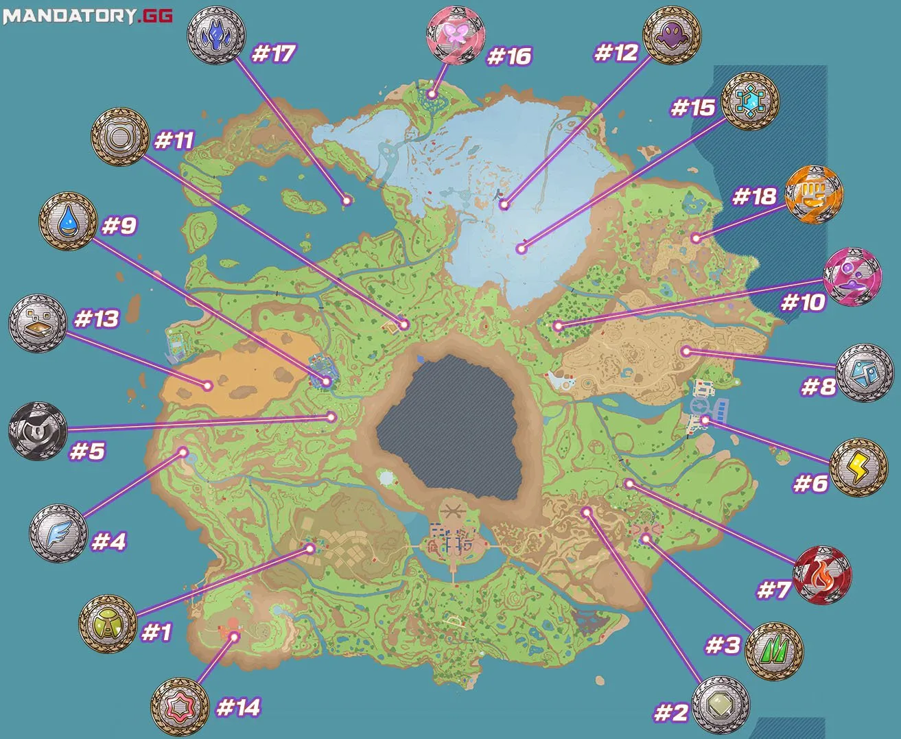
Reinforcement Learning Explanation with Pokémon Violet
Each point on the map is a gym
You need to go to each gym and defeat the leader to level up
By following the correct order, you will level up efficiently to beat the elite four
Following the incorrect order will allow you to level up but will be inefficient and may cause player to lose gym challenges
Imagine an agent being put into this map with no context and only knowing they need to beat the elite four.
Notes:
We can create an agent to navigate this world that will take in wins as positive feedback and losses as negative feedback
We can also shape the behavior by valuing HP after challenges and battles
By shaping the rewards, the agent can effectively master the environment in any way we would like

Slide 22
What is Reinforcement Learning? (cont.)
The agent will interact with an external environment and generate a model or data from its decision-making process that can be stored for later use
An agent will typically try to balance exploration with exploitation after it has garnered enough data to do so
Exploitation limits the consideration of new decision-making processes
Exploration can limit the optimization of a decision-making process within a given system
We will explore all aspects of this throughout the workshop and strike a balance between exploitation and exploration!

Slide 23
Bandit Algorithms History
1933 – Thompson Sampling (William R. Thompson):
One of the earliest solutions; uses probability distributions to model uncertainty and make decisions.
1952 – Herbert Robbins:
Formally introduced the multi-armed bandit problem in statistics, framing it as a foundational exploration problem.
1974 – Gittins Index (John C. Gittins):
Provides an optimal strategy for certain types of bandit problems using dynamic programming.
1985 – Auer et al. & UCB (Upper Confidence Bound):
Introduced a family of algorithms that balance reward and uncertainty. Became central in online learning and RL.
2000s – Contextual Bandits & Online Learning:
Bandit models expanded to include contextual information, enabling more personalized decision-making (e.g., recommender systems, ads).
2010s–Present – RL Integration & Real-World Applications:
Bandit strategies are now used in recommendation engines, clinical trials, adaptive experiments, and integrated into LLM fine-tuning (e.g., RLHF).

Slide 24
What Are Bandit Algorithms?
The Core Idea:
Bandit algorithms are a class of decision-making algorithms that help choose between multiple options (or "arms") in order to maximize rewards over time, while handling the trade-off between:
Exploration — Trying new or uncertain options to gather more information
Exploitation — Choosing the best-known option to get the highest reward

Slide 25
What Are Bandit Algorithms (CONT.)
Imagine you're in an arcade with several machines(a.k.a. "bandits")
Each machine has an unknown (determined) payout rate (e.g. points, tickets, etc.)
In this scenario we are controlling for a given person’s skillset
it remains constant
Your goal is to maximize your total reward over time
But you must balance:
Exploration – trying different machines to learn their payouts
Exploitation – sticking with the machine that seems to pay out the most

Slide 26
Types of Multiarmed Bandits
Epsilon-Greedy: Randomly explores some of the time, exploits the best option otherwise
UCB (Upper Confidence Bound): Picks the option with the highest potential upper-bound reward
Thompson Sampling: Uses Bayesian methods to model uncertainty and make probabilistic choices
Notes:
We will focus on epsilon greedy for today

Slide 27

Applications of Bandit Algorithms
Online advertising
Recommender systems
Clinical trials
Most Importantly:
RLHF (Reinforcement Learning from Human Feedback) in LLMs

Slide 28

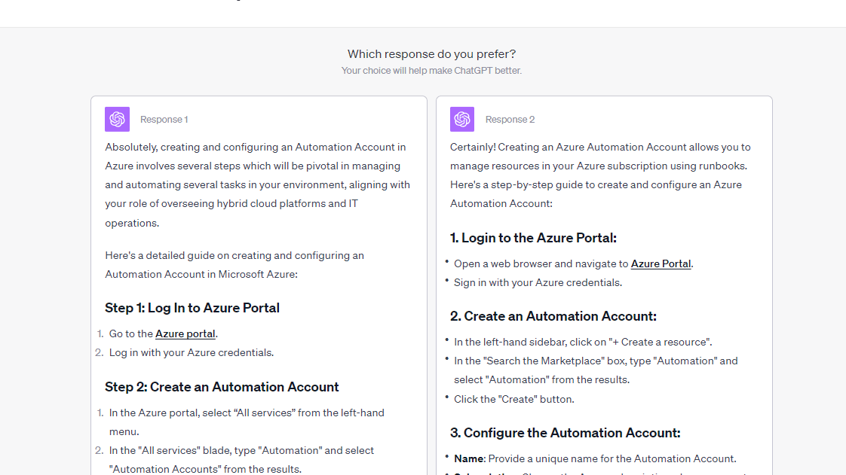
Notes:
Example: ChatGPT

Slide 29
Filling in the Blanks: What You Need to Know
Try Every Prompt at Least Once
Replace with:
self.num_arms for the number of prompts
arm inside the loop
Why: We want to make sure each prompt gets a chance before the algorithm starts picking favorites.
Calculate Each Prompt’s Score
Replace with:
self.values[arm] / self.counts[arm]
Why: This gives us the average reward (how well the prompt performs) for each prompt.
Update the Prompt’s Score After Use
Replace with:
Reward
Why: After trying a prompt, we add the score it got to help the algorithm learn over time.
Set Up the Optimizer with Correct Info
Replace with:
ollama_model, prompt_variants, and ground_truth
Why: These values are passed in when creating the optimizer — you just need to store them in the class.

Slide 30
Filling in the Blanks: What You Need to Know (CONT.)
Set LLM Temperature
Replace with:
0.0 for temperature
Why: Keeps the model's responses consistent so we can fairly compare prompt performance.
Skip Empty or Failed Responses
Replace with:
if not llm_response:
Why: Don’t try to score a response if it’s blank or there was an error.
Fill In the Core Method Calls
Replace with:
self.bandit.select_arm()
self.get_llm_response(...)
self.evaluate_response(...)
Why: These are the main actions — pick a prompt, get a response, give it a score.
Choose the Right Model Name
Replace with:
"llama3.2" or any model you pulled with Ollama
Why: The code needs to know which model to use to generate answers.

Slide 31

Bandit Code Base Review
Notes:
For this code the different “arms” or “bandits” will be different prompts and there will be attached rewards based on how well the LLM explains the code.

Slide 32
History of Reinforcement Learning from Human Feedback
2017 – Early Foundations:
Research begins on using human feedback to guide agent behavior, including preference-based RL in robotics and game-playing.
2018 – DeepMind & OpenAI Experiments:
OpenAI explores preference modeling via human comparisons in environments like Atari and robotics.
2020 – GPT Fine-Tuning:
OpenAI begins using RLHF to fine-tune GPT-2 models on tasks like summarization using human preferences.
2022 – ChatGPT Launch:
OpenAI uses RLHF to fine-tune GPT-3.5, resulting in ChatGPT – a conversational model better aligned with human intent.
2023–Present – Widespread Adoption:
RLHF becomes a standard method in building safe, useful LLMs across research labs and companies (e.g., Anthropic's Claude, Google’s Gemini).

Slide 33
What is Reinforcement Learning from Human Feedback?
Definition:
RLHF is a technique that trains AI models to align better with human intent by combining reinforcement learning with human-generated feedback.
How It Works (Simplified Steps):
Pretraining:
A large model (like GPT) is trained on massive amounts of text data.
Supervised Fine-Tuning:
Human labelers provide high-quality responses to sample prompts, and the model is fine-tuned to mimic them.
Reward Model Training:
Human labelers compare outputs and rank them → a reward model is trained to score model responses.
Reinforcement Learning:
The base model is further trained using reinforcement learning to maximize reward scores given by the human-aligned reward model.

Slide 34
Examples of RLHF with LLMs
RLHF is widely used to make language models more aligned with human expectations, safer, and more useful.
ChatGPT (OpenAI)
Fine-tuned with RLHF to follow instructions, refuse unsafe requests, and generate helpful answers
Feedback from human reviewers helps shape tone, clarity, and factual correctness
Claude (Anthropic)
Trained using Constitutional AI, a variant of RLHF guided by written principles instead of direct human rankings
Emphasizes safety, honesty, and value alignment without relying heavily on human labelers
Notes:
Typically, unless ChatGPT changes numbers (notably like the shift from GPT 3.5 to 4o) The differences in models like 4 omni and 4 mini come down to finetuning with tools like RLHF rather than retraining an entire model

Slide 35
Filling in the Blanks: What You Need to Know
To complete the RLHF Code Base, you’ll need to replace the FIXME placeholders with contextually appropriate values. Here's what each one represents conceptually:
Original Prompt & Candidate Response
Used when the critic evaluates a generated response. You need to pass the original user input and the model’s output so the critic can judge its quality.
Model Names
Specify which models are being used:
You may use other models than llama3.2 but you will need to find the documentation on the names for yourself
Policy model generates candidate responses
Critic model evaluates those responses based on human-like feedback
These should be models that are pulled and available in Ollama.

Slide 36
Filling in the Blanks: What You Need to Know (CONT.)
Critic & User Scoring Functions
These are the functions responsible for assigning scores to each response:
One score comes from the AI critic
The other comes from you (the human-in-the-loop)
The system will choose the final score based on which is available or preferred.
Report Data Placeholders
At the end of the process, data about the session — including prompt, responses, scores, and best result — is collected into a summary report. Make sure you replace all placeholders with the actual data gathered during the session.

Slide 37

Reinforcement Learning From Human Feedback Code Base Review

Slide 38

Lunch Break

Slide 39
History of LLM Fine-Tuning & Settings Configuration
Early Stages (Pre-2018):
Language models were task-specific, fine-tuned individually for things like classification or translation.
Fine-tuning involved full model retraining on labeled datasets — expensive and inflexible.
The Shift to General-Purpose LLMs:
BERT (2018): Introduced the idea of pretraining + task-specific fine-tuning — powerful and generalizable.
GPT-2 / GPT-3 (2019–2020): Popularized zero-shot and few-shot prompting, reducing the need for traditional fine-tuning in many cases.
Instruction Fine-Tuning (2021+):
Models like T5 and InstructGPT trained with datasets specifically designed for following user instructions.
Fine-tuning now focused on alignment, usability, and helpfulness — not just task performance.

Slide 40
History of LLM Fine-Tuning & Settings Configuration (CONT.)
Reinforcement Learning from Human Feedback (RLHF):
Emerged to fine-tune models based on human preferences (e.g., safety, clarity, usefulness), not just labels.
Used in models like ChatGPT, Claude, and Gemini.
The Rise of Configurable Inference Settings:
To control output without retraining, users can now adjust:
Temperature: Controls randomness
Top-k / Top-p: Limit token selection range
Max Tokens: Caps output length
Stop Sequences: Define custom stopping points
Streaming: Controls whether output appears gradually or all at once
Today:
Fine-tuning and inference settings work together:
Fine-tuning shapes the model’s behavior globally; settings tweak it per request.

Slide 41
What is Fine-tuning?
Definition:
Fine-tuning is the process of taking a pretrained language model and training it further on a smaller, task-specific dataset to specialize its behavior or improve performance on a targeted goal.
Why Fine-Tune a Model?
Adapt a general-purpose model to a specific task, domain, or tone
Improve performance in niche applications (e.g., legal, medical, technical writing)
Align the model with organization-specific knowledge or custom instructions

Slide 42
What is Fine-tuning? (CONT.)
Types of Fine-Tuning:
Supervised Fine-Tuning: Using labeled examples (e.g., question → correct answer)
Instruction Fine-Tuning: Teaching the model to follow human instructions more effectively
RLHF (Reinforcement Learning from Human Feedback): Using human preferences to guide learning
LoRA / Adapter Tuning: Lightweight methods that adjust only parts of the model
Fine-Tuning vs. Prompting:
Prompting = influence behavior at runtime (temporary)
Fine-tuning = permanently changes model behavior (long-term)

Slide 43
What Are LLM Settings Configurations?
Definition:
Settings configurations are adjustable parameters that control how a language model generates responses — without changing the model’s underlying training or structure.
Why Use Them?
Customize output style, length, and creativity
Improve user experience without retraining
Useful for experimentation, prototyping, or application-specific tuning
Common Configuration Parameters:
Temperature:
Controls randomness in output
Low = more focused and predictable
High = more diverse and creative

Slide 44
What Are LLM Settings Configurations? (CONT.)
Top-k / Top-p Sampling:
Limits token selection to top k or cumulative probability p
Helps balance coherence and variety
Max Tokens:
Sets the maximum length of the generated response
Stop Sequences:
Tells the model when to stop generating (useful for formatting or dialog control)
Streaming:
Enables output to appear in real-time, token by token

Slide 45
Why Use THESE LLM Settings?
Flexible Behavior Without Retraining
Change how the model responds — no fine-tuning needed.
Easy Experimentation
Try different tones, styles, and response types with just a setting change.
More Control
Limit response length, avoid repetition, and guide structure.
Performance Boost
Speed up responses and reduce resource use with streaming or max token limits.
One Model, Many Use Cases
Adapt the same model for creative writing, technical answers, or chatbots.

Slide 46
Filling in the Blanks: What You Need to Know
Critic Prompt Construction (Rating Section)
Replace with:
original_prompt and candidate_response
Why: Fills in the prompt sent to the critic model so it knows what to rate and what it’s rating.
Calling the Critic
Replace with:
critic_model in get_llm_response(...)
Why: You’re telling the system which model should act as the critic to give a score.
Getting the User’s Feedback
Replace with:
get_user_rating(...)
Why: This calls the function that shows the response to the user and asks for a rating. You’re passing the response, the critic’s score, and the original prompt.

Slide 47
Filling in the Blanks: What You Need to Know (CONT.)
Printing Model Names and Prompt Info at Start
Replace with:
policy_model, critic_model, and user_prompt
Why: Just prints out the actual values to the screen at the start of the demo — gives context.
Calling get_reward_from_critic(...)
Replace with:
Function call using critic_model, user_prompt, and the response
Why: This triggers the critic to evaluate the current candidate response.
Final Report Data Setup
Replace with:
Values for policy_model, critic_model, user_prompt, scored_responses, and best_response_info
Why: This collects all the results into one dictionary for the final text report.

Slide 48

LLM Configuration Code Base Review

Slide 49
History of RL Loops
1950s–1980s: Foundations
Richard Bellman introduced Markov Decision Processes (MDPs) — the backbone of RL loops
Early RL models used trial and error to learn simple behaviors
1980s–1990s: Learning Through Feedback
Temporal Difference (TD) Learning and Q-Learning emerged
Agents began learning from delayed rewards, forming the basis of modern feedback loops
2000s: Loop Becomes Formalized
RL loops structured into key stages: Observe state, Take action, Receive reward, Update policy
2010s: Deep Reinforcement Learning
Deep Q-Networks (DQNs) combined RL loops with neural networks
Loop frameworks applied in Atari, Go, and complex environments
2020s: RL for Language Models
RL loops adapted to train LLMs using human feedback (RLHF)
Loop includes response generation → feedback → reward modeling → policy update
Today: Efficient & Aligned RL Loops
Loops now include simulated environments, human scoring, and automated critics
Used in safety-critical systems, dialogue optimization, and preference alignment

Slide 50
What Are RL Loops?
Core Idea:
An RL loop is a cycle of learning where an agent interacts with an environment to learn which actions lead to the best outcomes.
The Basic Loop:
Observe:
The agent sees the current state of the environment
Act:
It chooses an action based on its policy
Receive Reward:
The environment gives feedback (positive or negative)
Learn:
The agent updates its behavior to do better next time
Goal:
Maximize long-term rewards by learning what to do in different situations through repeated interaction.

Slide 51
Filling in the Blanks: What You Need to Know
Temperature Setting (LLM Response Generation)
Controls randomness of LLM output.
Use temperature=0.0 for deterministic, consistent refinement.
Use higher values (e.g., 0.7) for diverse outputs during early exploration.
Replace with:
0.0 (recommended for optimization steps)
Word Count Thresholds (Conciseness Reward)
Helps decide if output is too short, too long, or just right.
Set word count cutoffs for:
Concise Bonus: e.g., < 60 words
Verbose Penalty: e.g., > 120 words
Replace with:
values like 60, 120

Slide 52
Filling in the Blanks: What You Need to Know (CONT.)
Keyword-Based Rewarding (Scientific Accuracy)
Add reward points for key terms that reflect accurate scientific explanation.
For example:
"rayleigh scattering" → +0.5
"wavelength" → +0.3
"blue light" + "scatter" → +0.4
Replace with: floats like 0.3, 0.5 (based on relevance)
Error & Missing Info Penalties
Penalize LLM if:
It returns errors or vague text
Omits basic concepts like "sun" or "light"
Replace with: negative rewards like -0.5, -1.0

Slide 53
Filling in the Blanks: What You Need to Know (CONT.)
Tool Selection Heuristics
Logic that chooses which refinement tool to use next, based on:
Current reward score (e.g., < 0.5)
Output length
Missing elements (like examples or detail)
Replace with:
Score thresholds like 0.5, 1.0
Length thresholds like 80 words
Number of Optimization Iterations
Controls how many steps the model takes to refine the output.
Replace with:
an integer like 5, 10, or more depending on goal

Slide 54
RL Loops Code Base Review

Slide 55
Additional Notes
Other technologies like Ollama exist such as vLLM
Please see the end of this presentation (in Github) to find more resources on LLM and RL development.

Slide 56

Capstone Project
Notes:
Now is the time to experiment and put all of your learned skills together into a capstone project, this section is optional however it is encouraged for those seeking to deepen their understanding

Slide 57

Thanks for coming!

Slide 58
References: Large Language Models (LLMs)
Foundational Concepts:
Chomsky, Noam. Introduced transformational grammar and innate linguistic structures (1950s–1960s).
Shannon, Claude. Father of information theory; laid mathematical groundwork for modeling language statistically (1948).
Manning, Christopher, & Schütze, Hinrich.
Foundations of Statistical Natural Language Processing (1999).
Vaswani, Ashish, et al. "Attention Is All You Need" (2017) – introduced the Transformer architecture.
Key Models & Developments:
Bengio, Yoshua, Hinton, Geoffrey, & LeCun, Yann. Pioneers in deep learning for neural networks leading to NLP and LLM breakthroughs (2000s).
Devlin, Jacob, et al. Introduced BERT (2018).
Radford, Alec, et al. Led development of the GPT series at OpenAI (2018–2020).
OpenAI. GPT-2 / GPT-3 (2019–2020) – popularized zero-shot and few-shot prompting.
Models like T5 and InstructGPT (2021+) – for instruction fine-tuning.

Slide 59
References: Reinforcement Learning (RL) & Bandit Algorithms
Foundational Concepts in RL:
Bellman, Richard. Introduced Markov Decision Processes (MDPs) (1950s–1980s).
Temporal Difference (TD) Learning and Q-Learning emerged (1980s–1990s).
Bandit Algorithms History & Key Figures:
Thompson, William R. Thompson Sampling (1933).
Robbins, Herbert. Formally introduced the multi-armed bandit problem (1952).
Gittins, John C. Gittins Index (1974).
Auer, Peter, et al. & UCB (Upper Confidence Bound) algorithms (1985).

Slide 60
References: Reinforcement Learning from Human Feedback (RLHF) & Fine-Tuning
RLHF Developments:
Early research on human feedback for agent behavior (2017).
DeepMind & OpenAI experiments on preference modeling via human comparisons (2018).
OpenAI used RLHF to fine-tune GPT-2 models for summarization (2020).
OpenAI used RLHF to fine-tune GPT-3.5, resulting in ChatGPT (2022).
RLHF became a standard method for LLMs, including Anthropic's Claude and Google's Gemini (2023–Present).
Fine-Tuning Concepts:
Supervised Fine-Tuning.
Instruction Fine-Tuning.
LoRA / Adapter Tuning.

Slide 61
Additional Resources
Large Language Models (LLMs):
"Attention Is All You Need" Paper: The foundational paper introducing the Transformer architecture. (Available on arXiv: https://arxiv.org/abs/1706.03762).
Hugging Face Transformers Library Documentation: Comprehensive resource for using and understanding various transformer models.
OpenAI API Documentation: Explore how to interact with models like GPT series and learn about their parameters.
vLLM Documentation:
https://docs.vllm.ai/en/latest/

Slide 62
Additional Resources
Reinforcement Learning (RL) & Bandit Algorithms:
Sutton & Barto, Reinforcement Learning: An Introduction: A classic textbook providing a deep dive into RL theory and algorithms.
PyTorch/TensorFlow RL Libraries: Official documentation and tutorials for implementing RL algorithms in popular deep learning frameworks.
Multi-Armed Bandit Problem Literature: Search for papers and resources on Epsilon-Greedy, UCB, and Thompson Sampling for detailed explanations and proofs.

Slide 63
Additional Resources
Reinforcement Learning from Human Feedback (RLHF):
OpenAI's Blog Posts on ChatGPT and InstructGPT: Provide insights into the application of RLHF for aligning language models with human intent.
Anthropic's Constitutional AI Papers: Explore alternatives and variants of RLHF, such as training models with written principles.
OpenRLHF: https://github.com/OpenRLHF/OpenRLHF

